Slide 1
MAMC01801 Capabilities for Managers
WEEK 1

Slide 2
A Thought To Begin With
“Education is not what the teacher does; it is a process spontaneously carried out by the human individual. It is acquired not by listening to words, but by experiencing an environment. The task of the teacher is to prepare a series of activities located in that environment, and then refrain from interference in the process”
(adapted from Maria Montessori, n.d.)

Slide 3
Agenda
Welcome
Course overview - course outline, structure, expectations, assessments
The interactive triad – organisations, environments, individuals
Contemporary influences – hyper-competition, globalisation, technological advances
Assignment 1: requirements overview

Slide 4
Who Am I ?

Slide 5
Five Questions
In what month were you born?
What part of Auckland are you currently living in?
What is your favourite main course food?
If you could buy a new car tomorrow, what colour would it be?
If you had to learn a language, other than your own first language and English, what would you choose to learn?

Slide 6
Key Points From the Outline
The dual model of study – F2F and SDL
Need for commitment to attendance and participation
Availability of faculty guidance and advice
Library session on Session 2 or 3
Review of Assignment 1 on Session 4

Slide 7
This Afternoon’s Topics
Topic 1: the interactive triad
Topic 2: the organisational purpose
Topic 3: the organisational life cycle

Slide 8
Topic 1: the interactive triad
a range of individual people with different tasks to perform in the production of goods and/or services.
a number of organisations that have been formed for the specific purpose of producing and distributing those goods and services.
the organisational environment, or the physical, societal, and ecological characteristics that influence the way in which those people and organisations conduct their activities.

Slide 9
A Three Minute Verbal Presentation
What are the most important differences between the organisations described in those three job advertisements?
What are the most important differences between the organisational environments that those three job advertisements refer to?
In respect of each job advertisement, what would be the three most useful capabilities an individual could bring to the job?
What lessons are there for intending managers?

Slide 10
Organisational Purpose – What Do They Do?
Obtain a range of “input” resources needed to produce goods or services - financial, tangible, intangible, or human. These resources have to be acquired from outside the organisation’s boundaries.
Apply some form of process, inside of the organisation, to “convert” the acquired inputs into something that customers or service users can benefit from. This stage does happen inside the organisation and is therefore theoretically controllable by managers.
Deliver the completed products or service in the form of an “output” to the external environment. This output stage occurs outside of organisational boundaries.

Slide 11
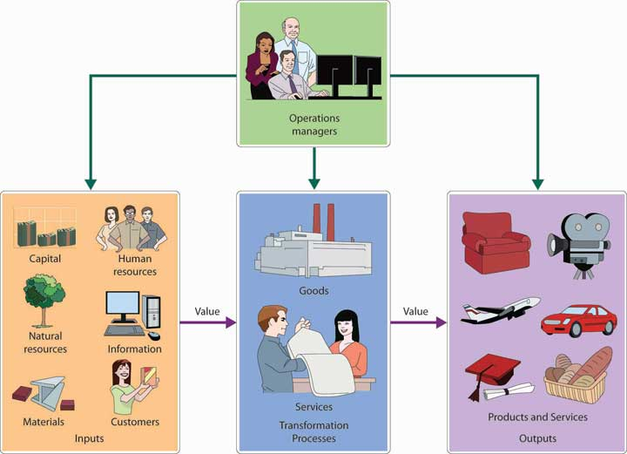
EI> IC> EO

Slide 12
What EIs, what ICs, What EOs?
A restaurant
A bank
A hairdressing salon
A hospital
A polytechnic delivering postgraduate business programmes!

Slide 13
Some Things for Managers to Worry About
Effective and efficient management of the resource acquisitions process
Effective and efficient management of the internal conversion process
Effective and efficient management of the product/service distribution process

Slide 14
Some Things for Managers to Worry About
“Effectiveness” is a measure of the extent to which a process achieves what it sets out to achieve
“Efficiency” is a measure of the volume of resources used to achieve an effective result
Effectiveness + Efficiency = Productivity!

Slide 15
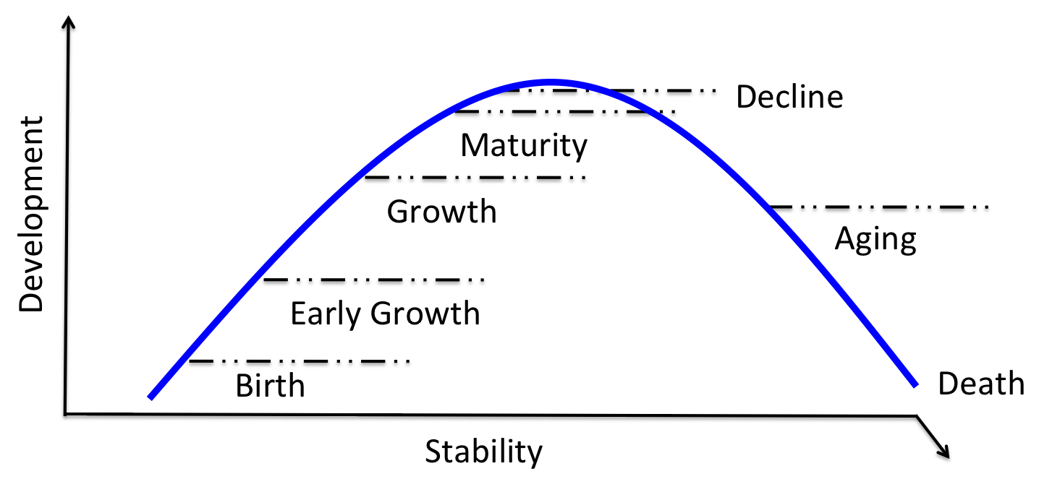
The Organisational Life Cycle

Slide 16
A Longer Life!
Market penetration (securing a bigger share of a market the firm already competes in)
Market development (finding new people to buy what it has always produced)
Product development (finding new products to sell to customers it already possesses)
Diversification (developing new products and services to sell to new customers)

Slide 17
The Development of Globalisation
Post-industrial organisations developed slowly and steadily 1920-1980.....but then?
Disintegration of trade barriers and emergence of economic challenge to political boundaries
Move from product to service based economies
Massive technological transformation
Notable shift in economic power away from USA/Europe/Japan, and towards BRIC countries
New Zealand is now an outer suburb of the global village!

Slide 18
Globalisation: Winners and Losers?
Globalisation claimed to be good for first world countries, even better for second and third world countries ... Is this really true?
Some large organisational economies are bigger than many small country economies. New Zealand’s annual production value is about the same as that of tobacco conglomerate Philip Morris
Who are the current and political superpowers; and who will be future economic superpowers?
Important – the global future will be determined by economics rather than politics

Slide 19
How Has This Happened?
Steady shift from product to service economies
Rapid increases in the capability of information and communications technologies
Rapidly reducing real cost of transportation and freight
Progressive dismantling of border crossing restrictions
Steady reductions in restrictive regulation
Globalised financial and labour markets

Slide 20
A Summary of Impacts
Globalisation means the production of goods and services in low production cost locations; and the sale of goods and services in high income locations. This need is addressed by a small number of multi-national mega-corporations, and a very large number of small sub-suppliers. The future for “medium-sized” organisations does not look positive.
Organisations have an almost limitless capacity to deliver goods and services, while consumers are fast reaching the limits of their capability to acquire them. This means that most organisations are fighting for survival in an environment of over-supply.
AI use is growing tremendously, therefore, instead of fearing AI, how can we leverage AI to increase human capabilities?

Slide 21
Implications for Assignment 1
Today’s managers are indeed required to “manage things today”
But are much more importantly required to “lead people into tomorrow”
In short, the manager’s job is far more closely related to people than to processes
Key tasks include establishing a positive and inclusive environment inside the organisation; placing high value on innovation and creativity; and willingly embracing the need for continuous change
It is those three requirements that form the basis for Assignment 1

Slide 22
In/out-of-class activity
Think of TWO New Zealand-based organisations for your Assessment One;
Planning in advance: Search for TWO types of organisations – For-profit; Not-for-profit; Māori organisation; Government organisation;
Select TWO organisations from TWO different categories; advisable to include one Māori organisation;
Inform Sharan immediately & before you start your Assessment One

Slide 23
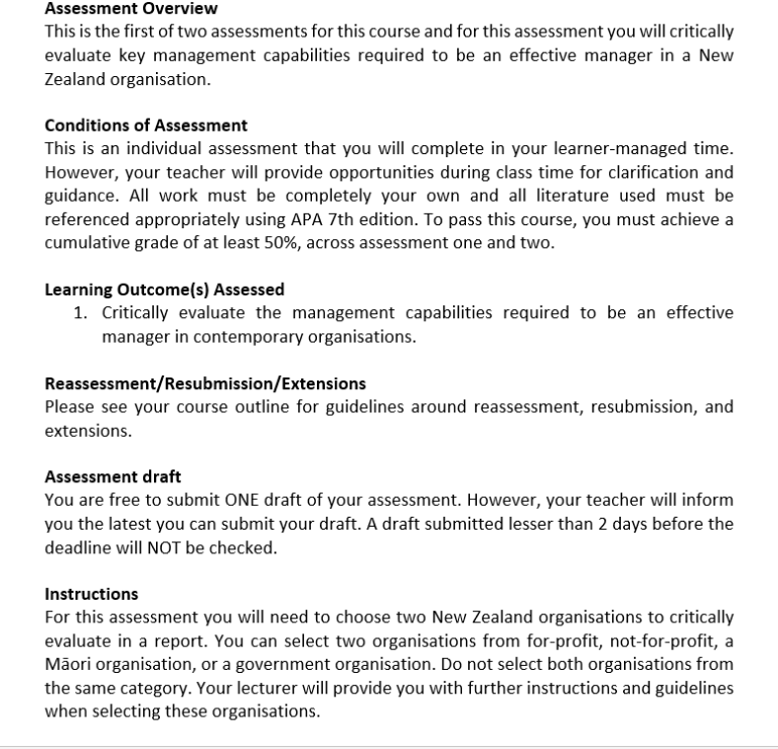
Assessment 1: Report (20% of final grade)
Word count guidance: 2000 words (+/- 10%)
Due date: Friday Week 3 (25 October 2024), 11:59 PM

Slide 24
Feedback for Assessment One
Written Feedback:
If you would like to obtain written feedback for your draft for Assessment One (or some paragraphs, or even just key points or outline), please upload your draft via Teams Assignments before Thursday morning (17 October, Week 2), 8.30 AM. The feedback will be released before Wednesday (23 October, Week 3).
Any questions? Feel free to contact me on Teams!

